Slide 1

WinkWare Winkware is an e-commerce company that sells Clothing, Electronics, Furniture on its site. Its clothing are known for their bold colors and whimsical designs
Explore unique trends and innovative styles to write the next chapter of your fashion self.

Slide 2
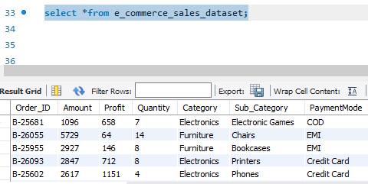

Information Extracted- Table columns, Table named as :- e_commerce_sales_dataset.
Write a Query to extract a table information.

Slide 3
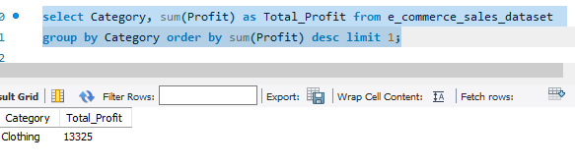
Which category is generating highest profit?
As Winkware is more focused on clothing and styling side so Clothing is generating highest revenue for the company.

Slide 4
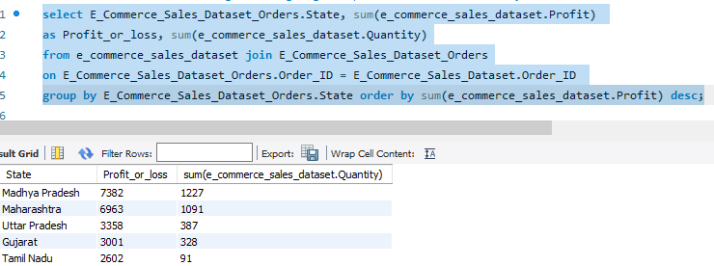
Retrieve the State name generating highest profit or loss & Quantity sold
Madhya Pradesh is the State generating the highest Profit with 1227 Quantity sold.

Slide 5
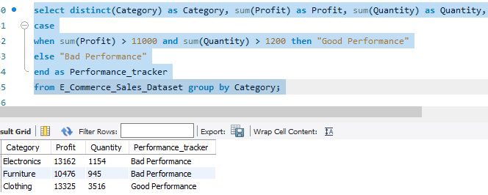
Show the performance tracker based on performance if Profit and Quantity >11000 and >1200 then good performance else bad performance.
Clothing is the category which is generating highest profit and Quantity sold is also high.

Slide 6
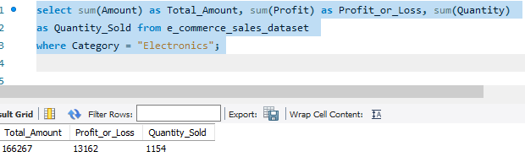
Retrieve is the total amount (Sales) delivered to Category- Electronics also retrieve the profit or loss generated & Quantity Sold.
Above are the detail of Electronics.

Slide 7
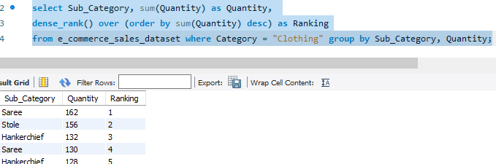
Retrieve Clothing Sub_Category Ranking as per Quantity sold.
Clothing Sub Category Ranking as per Quantity sold.

